Slide 1
Color space

Slide 2
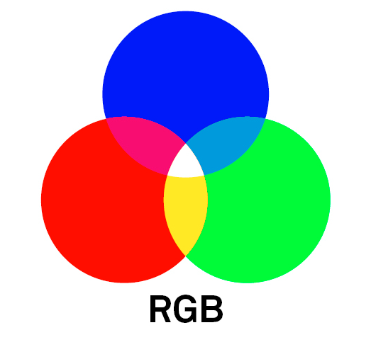
RGB
It is an additive colorspace where colors are obtained by a linear combination of Red, Green, and Blue values.
The three channels are correlated by the amount of light hitting the surface.
使用opencv讀取圖片時通道順序是BGR而非RGB

Slide 3
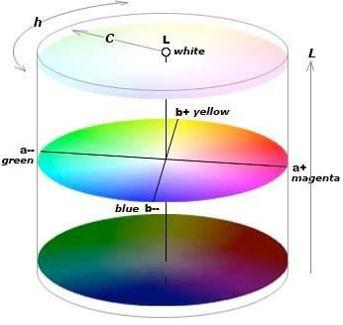
Lab
L – Lightness ( Intensity ).
a – color component ranging from Green to Magenta.
b – color component ranging from Blue to Yellow.
Lab color space, the L channel is independent of color information and encodes brightness only. The other two channels encode color.

Slide 4
Lab
Perceptually uniform color space which approximates how we perceive color.
Independent of device ( capturing or displaying ).
Used extensively in Adobe Photoshop.
Is related to the RGB color space by a complex transformation equation.

Slide 5
YCrCb is derived from the RGB color space
Y – Luminance or Luma component obtained from RGB after gamma correction.
Cr = R – Y ( how far is the red component from Luma ).
Cb = B – Y ( how far is the blue component from Luma ).
Separates the luminance and chrominance components into different channels. (將亮度和色度分量分成不同的通道。)
Mostly used in compression ( of Cr and Cb components ) for TV Transmission.
Device dependent.

Slide 6
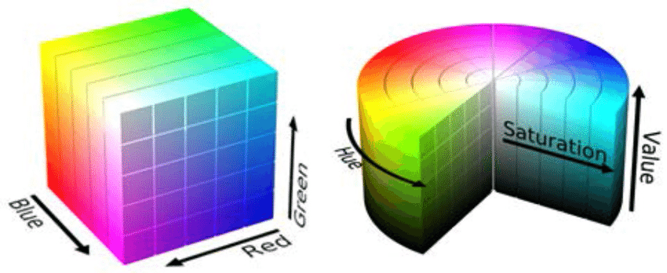
HSV
H – Hue ( Dominant Wavelength ). 色相
S – Saturation ( Purity / shades of the color ).飽和度
V – Value ( Intensity ). 值
Best thing is that it uses only one channel to describe color (H), making it very intuitive to specify color.
僅使用一個通道來描述顏色（H）
Device dependent.

